Slide 1

Introduction to Data Analytics
ITE 5201
Lecture10-Logistic Regression

Slide 2
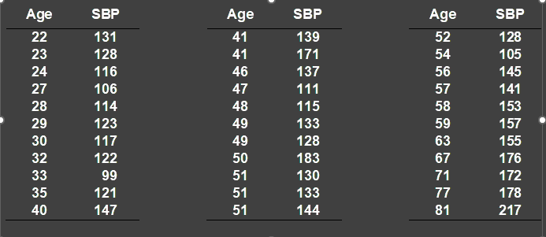

Simple linear regression
Table 1 Age and systolic blood pressure (SBP) among 33 adult women
Copyright © 2018 Pearson Education, Inc. All Rights Reserved.

Slide 3
SBP (mm Hg)
220
SBP = 81.54 + 1.222 ⋅ Age
200
180
160
140
120
100
80
20
30
40
50
60
70
80
90
Age (years)
adapted from Colton T. Statistics in Medicine. Boston: Little Brown, 1974
Copyright © 2018 Pearson Education, Inc. All Rights Reserved.

Slide 4
Simple linear regression
Relation between 2 continuous variables (SBP and age)
y
Slope
y = α + β₁x₁
x
Regression coefficient β₁
Measures association between y and x
Amount by which y changes on average when x changes by one unit
Least squares method
Copyright © 2018 Pearson Education, Inc. All Rights Reserved.

Slide 5
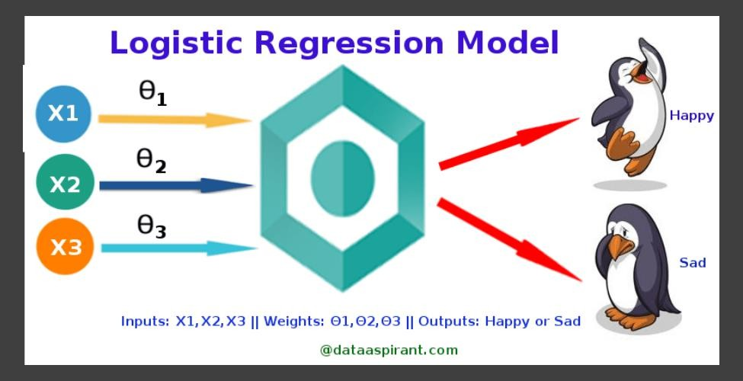
Logistic regression
Copyright © 2018 Pearson Education, Inc. All Rights Reserved.

Slide 6
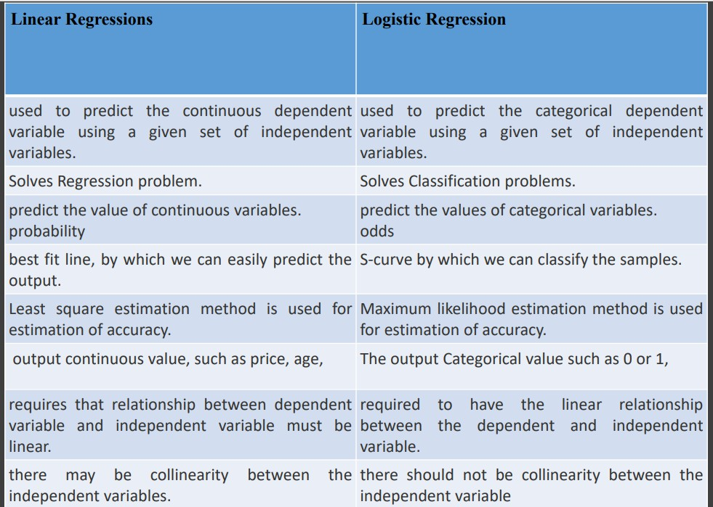
Copyright © 2018 Pearson Education, Inc. All Rights Reserved.

Slide 7
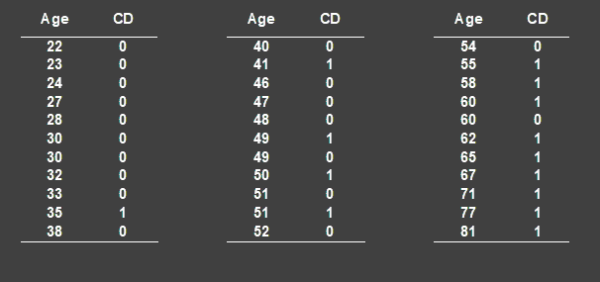
Logistic regression
Table 2
Age and signs of coronary heart disease (CD)
Copyright © 2018 Pearson Education, Inc. All Rights Reserved.

Slide 8
How can we analyse these data?
Compare mean age of diseased and non-diseased
Non-diseased: 38.6 years
Diseased: 58.7 years
(p<0.0001)
Linear regression?
Copyright © 2018 Pearson Education, Inc. All Rights Reserved.

Slide 9
Dot-plot: Data from Table 2
Yes
Signs of coronary disease
No
0
20
40
AGE(years)
60
80
100
Copyright © 2018 Pearson Education, Inc. All Rights Reserved.

Slide 10





Logistic regression
Linear regression is used to predict outputs on a continuous spectrum.
Example: predicting revenue based on the outside air temperature.
Logistic regression is used to predict binary outputs with two possible values labeled "0" or "1"
Logistic model output can be one of two classes: pass/fail, win/lose, healthy/sick
Hours Studying | Pass/Fail
1 | 0
1.5 | 0
2 | 0
3 | 1
3.25 | 0
4 | 1
5 | 1
6 | 1
PASS/FAIL
LINEAR MODEL
HOURS OF STUDYING
Copyright © 2018 Pearson Education, Inc. All Rights Reserved.

Slide 11



Logistic regression
Linear regression is not suitable for classification problem.
Linear regression is unbounded, so logistic regression will be better candidate in which the output value ranges from 0 to 1.
LINEAR MODEL
PASS/FAIL
LOGISTIC REGRESSION MODEL
HOURS OF STUDYING
Copyright © 2018 Pearson Education, Inc. All Rights Reserved.
Notes:
Logistic Regression is considered a regression model also. This model creates a regression model to predict the likelihood that a given data entry belongs to the category labeled “1.” Logistic regression models the data using the sigmoid function, much as linear regression assumes that the data follows a linear distribution.

Slide 12




Logistic regression
Logistic regression algorithm works by implementing a linear equation first with
independent predictors to predict a value.
We then need to convert this value into a probability that could range from 0 to 1.
PASS/FAIL
LOGISTIC REGRESSION MODEL
HOURS OF STUDYING
Copyright © 2018 Pearson Education, Inc. All Rights Reserved.

Slide 13

Logistic regression
FROM PROBABILITY TO CLASS
Now we need to convert from a probability to a class value which is “0” or “1”.
PASS/FAIL
LOGISTIC REGRESSION MODEL
Class 1
0.5
Class 0
THRESHOLD
HOURS OF STUDYING
Copyright © 2018 Pearson Education, Inc. All Rights Reserved.
Notes:
Logistic Regression is considered a regression model also. This model creates a regression model to predict the likelihood that a given data entry belongs to the category labeled “1.” Logistic regression models the data using the sigmoid function, much as linear regression assumes that the data follows a linear distribution.

Slide 14
Metrics
It is extremely important to use quantitative metrics for evaluating a machine learning model
For classification
Accuracy/Precision/Recall/F1-score, ROC curves,…
For regression
Normalized RMSE, Normalized Mean Absolute Error (NMAE)
Copyright © 2018 Pearson Education, Inc. All Rights Reserved.

Slide 15
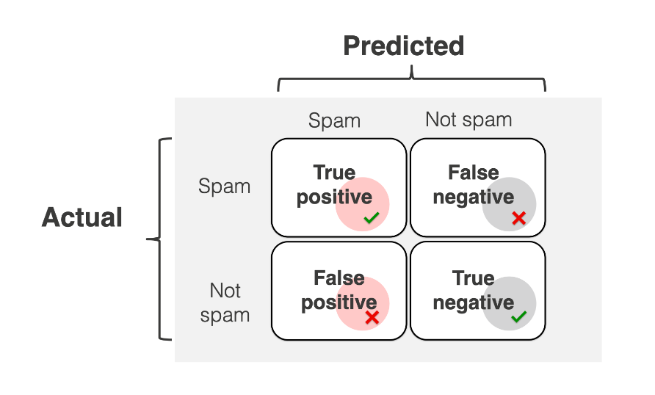
Metrics(Confusion Matrix)
Using the confusion matrix, you can visualize all 4 different outcomes in a single table.
Copyright © 2018 Pearson Education, Inc. All Rights Reserved.

Slide 16
Metrics(Confusion Matrix)
Correct predictions include so-called true positives and true negatives.
Think about email. We need to correctly identify and unpacks for our spam example:
True positive (TP): An email that is actually spam and is correctly classified by the model as spam.
True negative (TN): An email that is actually not spam and is correctly classified by the model as not spam.
Model errors include so-called false positives and false negatives. In our example:
False Positive (FP): An email that is actually not spam but is incorrectly classified by the model as spam (a "false alarm").
False Negative (FN): An email that is actually spam but is incorrectly classified by the model as not spam (a "missed spam").
Copyright © 2018 Pearson Education, Inc. All Rights Reserved.

Slide 17
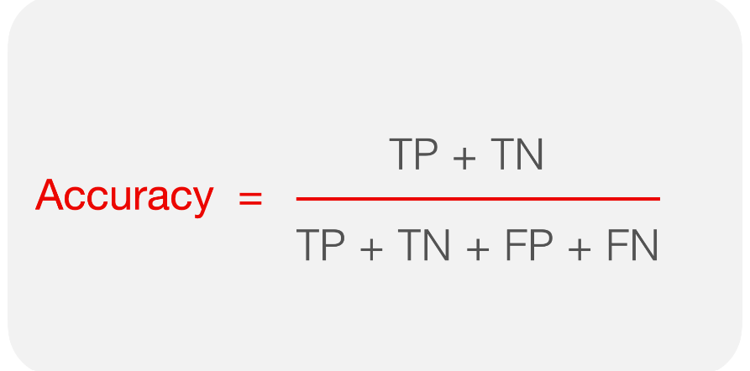
Metrics(Accuracy)
Copyright © 2018 Pearson Education, Inc. All Rights Reserved.

Slide 18
Metrics(Accuracy)
Accuracy ignores the specific types of errors the model makes. It focuses on “being right overall.” To evaluate how well the model deals with identifying and predicting True Positives, we should measure precision and recall instead.
Copyright © 2018 Pearson Education, Inc. All Rights Reserved.

Slide 19
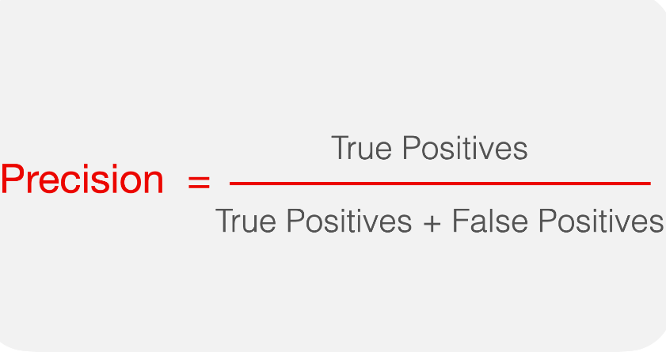
What is precision?
Precision is a metric that measures how often a machine learning model correctly predicts the positive class.
In other words, precision answers the question: how often the positive predictions are correct?
The higher the precision, the better. You can achieve a perfect precision of 1.0 when the model is always right when predicting the target class: it never flags anything in error.

Slide 20
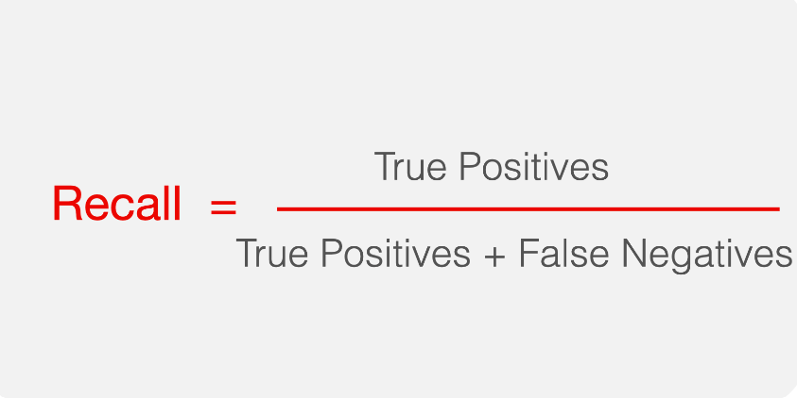
What is recall?
Recall is a metric that measures how often a machine learning model correctly identifies positive instances (true positives) from all the actual positive samples in the dataset.
In other words, recall answers the question: can an ML model find all instances of the positive class?

Slide 21
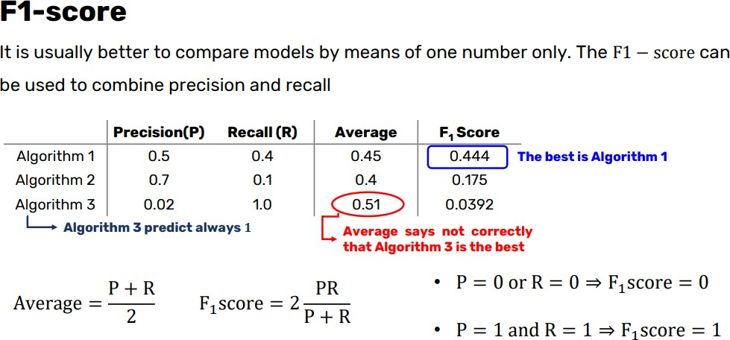
Metrics
Copyright © 2018 Pearson Education, Inc. All Rights Reserved.

Slide 22
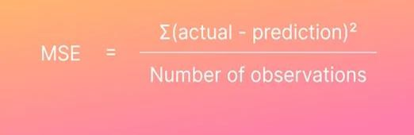
MSE
MSE (Mean Squared Error) is the average squared error between actual and predicted values.
Squared error, is a row-level error calculation where the difference
between the prediction and the actual is squared.
The main draw for using MSE is that it squares the error, which results in large errors being punished or clearly highlighted.
Copyright © 2018 Pearson Education, Inc. All Rights Reserved.

Slide 23
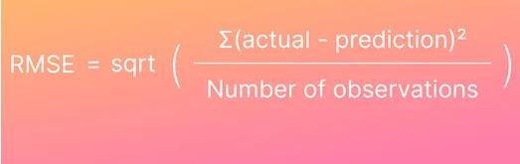
RMSE
Root Mean Squared Error (RMSE) is the square root of the mean squared error (MSE) between the predicted and actual values.
A benefit of using RMSE is that the metric it produces is in terms of the unit being predicted. For example, using RMSE in a house price prediction model would give the error in terms of house price, which can help end users easily understand model performance.
Copyright © 2018 Pearson Education, Inc. All Rights Reserved.

Slide 24
R squared compared to RMSE
RMSE (or MSE) is the measure of goodness of predicting the validation/test values, while R^2 is a measure of goodness of fit in capturing the variance in the training set.
R Square is not only a measure of Goodness-of-fit, it is also a measure of how much the model (the set of independent variables you selected) explain the behavior of your dependent variable.
Copyright © 2018 Pearson Education, Inc. All Rights Reserved.

